Slide 1

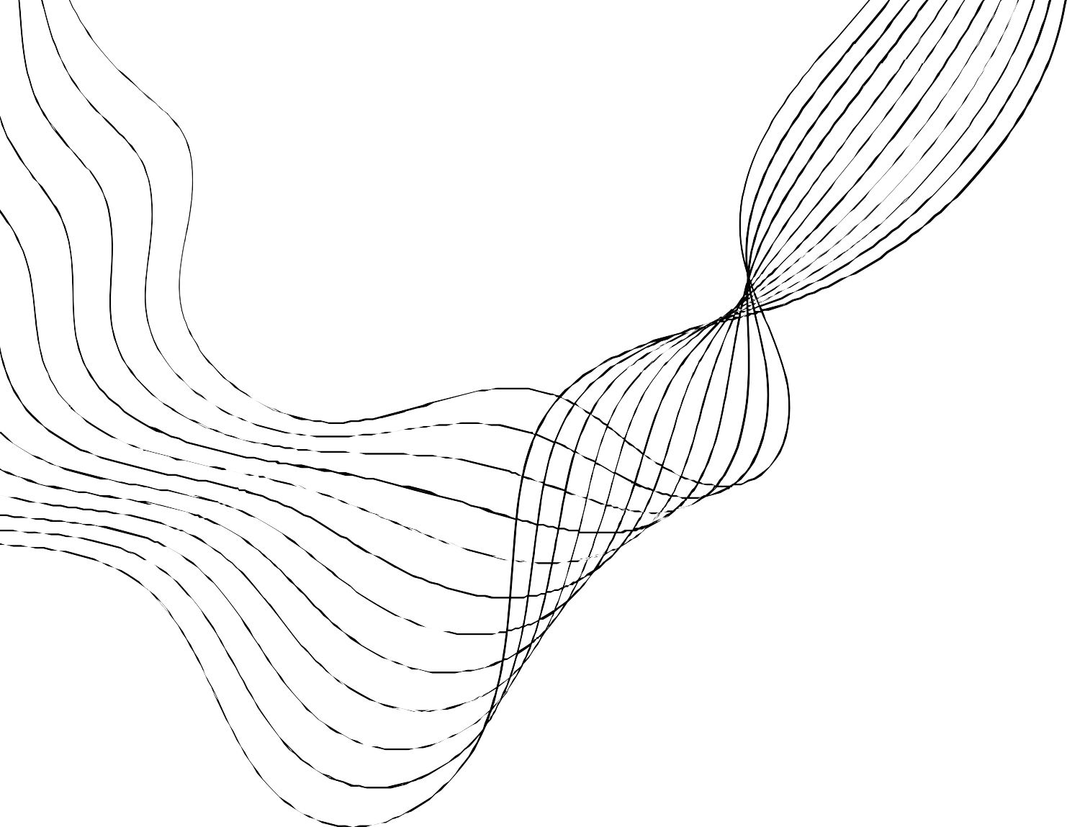


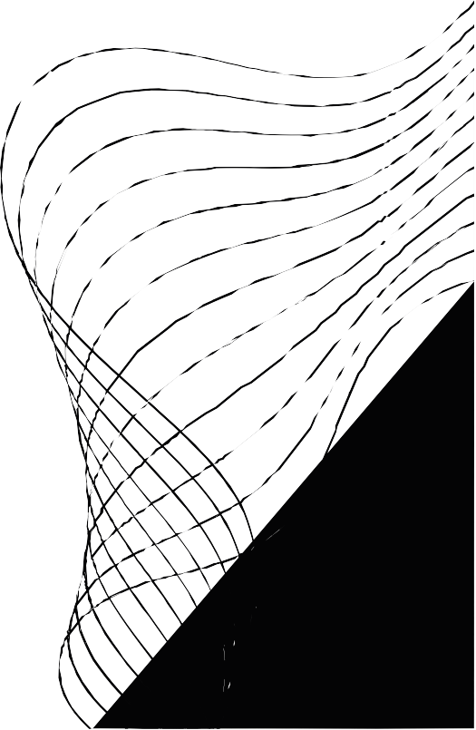
KALPATARU INSTITUTE OF TECHNOLOGY
ANALYZING THE RISK FACTORS ASSOCIATED WITH OBESITY/ OVERWEIGHT USING MACHINE LEARNING.
Under the Guidance of:
Submitted By:
Harish B M (BE, M.Tech) Assistant Professor
Dept of CSE KIT tiptur
Pavan Kumar N(1KI19CS059) Shreyas B R(1KI19CS100)
Vishveshwara M N(1KI19CS119) Vismaya K S(1KI19CS121)

Slide 2
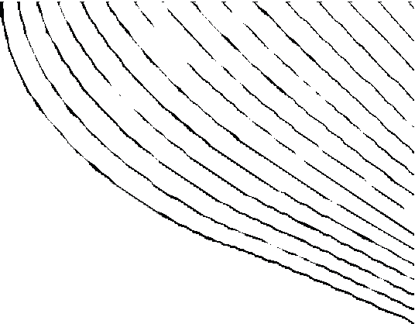
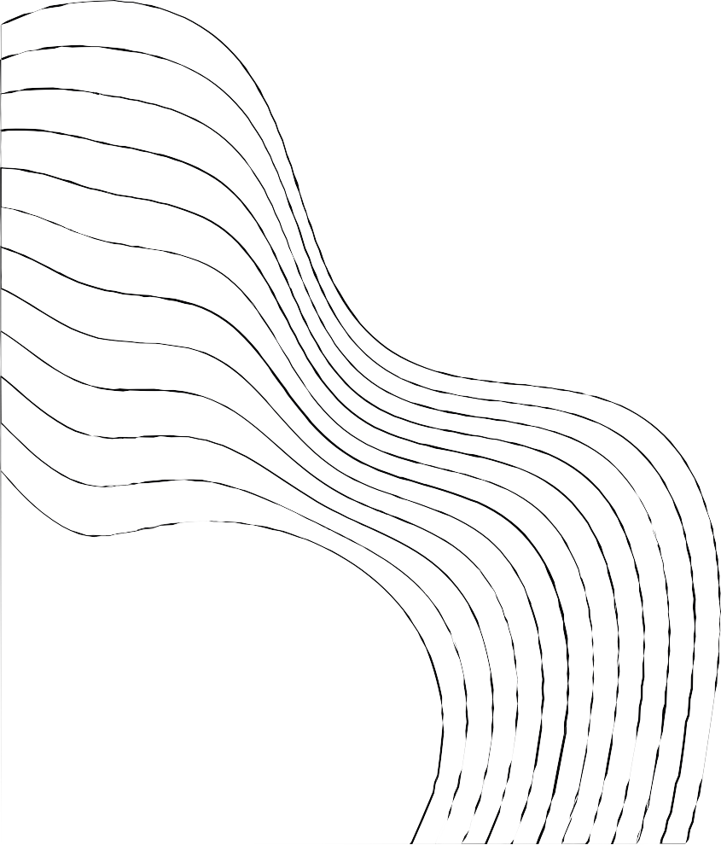
CONTENTS:
ABSTRACT
INTRODUCTION
PROBLEM STATEMENT
OBJECTIVES OF PROJECT EXISTING SYSTEM
PROPOSED SYSTEM
ARCHITECTURE DIAGRAM MODULES OF PROJECT
FLOW CHART SCREENSHOT CONCLUSION REFERENCES

Slide 3

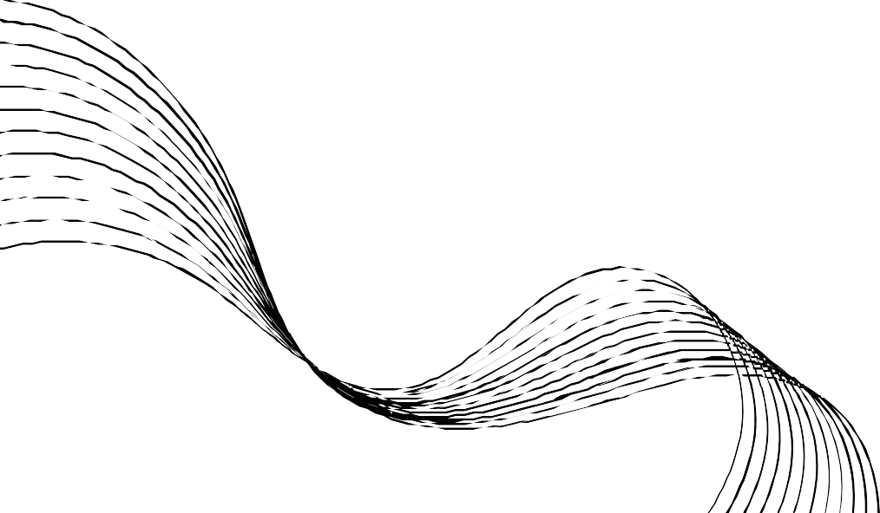
ABSTRACT:
Behavioral risk factors such as unhealthy habits, improper diet, and physical inactivity lead to physiological risks, and “obesity/overweight” is one of the consequences.
“Obesity and overweight” are one of the major lifestyle diseases that leads to other health conditions, such as cardiovascular diseases (CVDs), chronic obstructive pulmonary disease (COPD),
cancer, diabetes type II, hypertension, and depression.
It is not restricted within the age and socio-economic background of human beings.
Health behavior change should be given priority to avoid life-threatening damages.
This paper qualifies as a tutorial article on how to use different ML methods to identify potential risk factors of obesity/overweight.

Slide 4
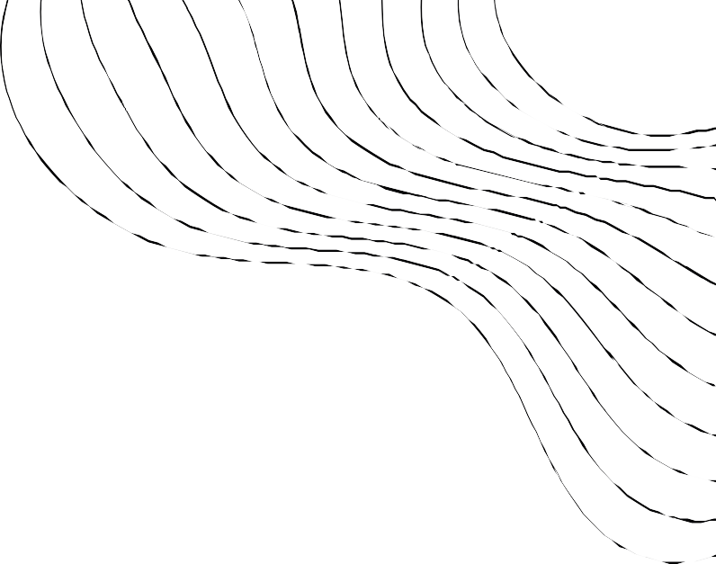
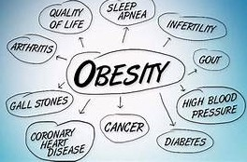
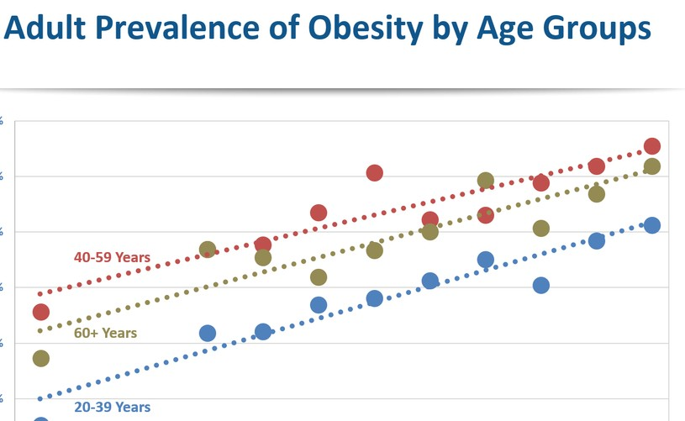
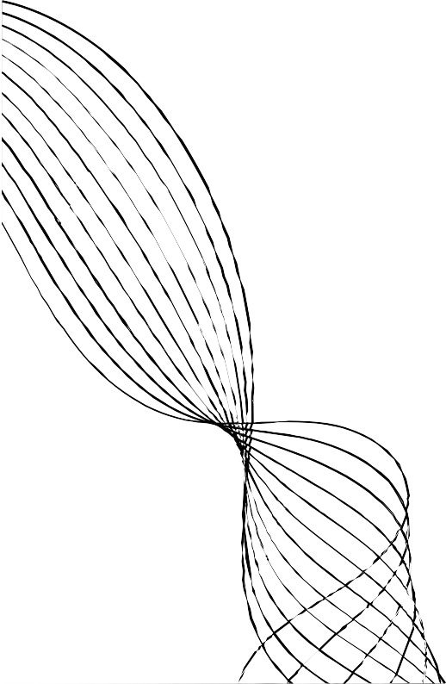
INTRODUCTION:
Our project aims to analyze the relationship between obesity and different risk factors such as BMI, Race, Gender, physical activities, mental health, education level,
and etc.
Obesity constitutes a major public health concern in the U.S. and Globally
About 1 in 5 children and more than 1 in 3 adults struggle with obesity in the U.S. (CDC)
Adults with obesity have higher risk for developing Heart disease, Type 2 diabetes, and some
types of cancer (CDC)
According to the “World Health Organization” (WHO), 30% of global death will be caused by lifestyle diseases by 2030.
There are limited number of studies using machine learning to analyze obesity related datasets in the U.S.

Slide 5


PROBLEM STATEMENT
Obesity is quickly becoming one of the most prominent conditions affecting children and adolescents.
Traditionally, treatment for obesity has been approached from a medical model.
More recent research has found that in addition to changes in physical activity and caloric intake (medical health); emotional, social, and psychological (mental health) factors must be
addressed in order to provide effective treatment to overweight and obese children and adolescents.
In order to promote this holistic approach to obesity treatment, it is necessary to examine the existing evidence and compile it in a format that is easily accessed as well as informative
for use of those in the medical health care professions.

Slide 6

EXISTING SYSTEM
In obesity researches, data mining techniques have been widely engaged to investigate the r isk factors.
Different advance machine learning algorithms have been used to that effect.
Algorithms of K- nearest neighbor, Logistic Regression, Random Forest, Support Vector Machine, Multilayer Perceptron, Adaptive Boosting, Naïve Bayes, Gradient oosting Classifier, and Decision Tree were used in designing models
Problems with existing system:
Inaccurate obesity diagnosis as patients are not diagnoses by an expert.
Only one feature is used which is the body measure thus prediction might not be correct.
Prone to low accuracy

Slide 7
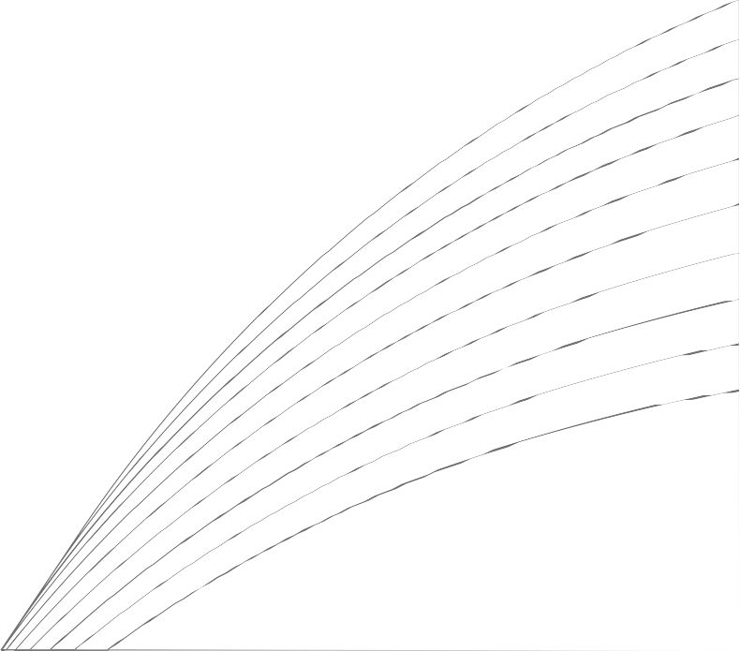
PROPOSED SYSTEM:
The proposed model will be build using the Python programming language, applying machine learning algorithm on the dataset collected from a healthcare center to model a system that will be capable of predicting obesity in patients with dataset that has been technically automated to suit the purpose of this research.
The system will have the following advantages.
Increase the reliability of result diagnosed
Reduce the trouble of diagnosis of obesity to the barest minimal
Provide real time system for classification of obesity
Saves time and cut cost required for various medical test.

Slide 8
ARCHITECTURE DIAGRAM
CUSTOMERS

Slide 9



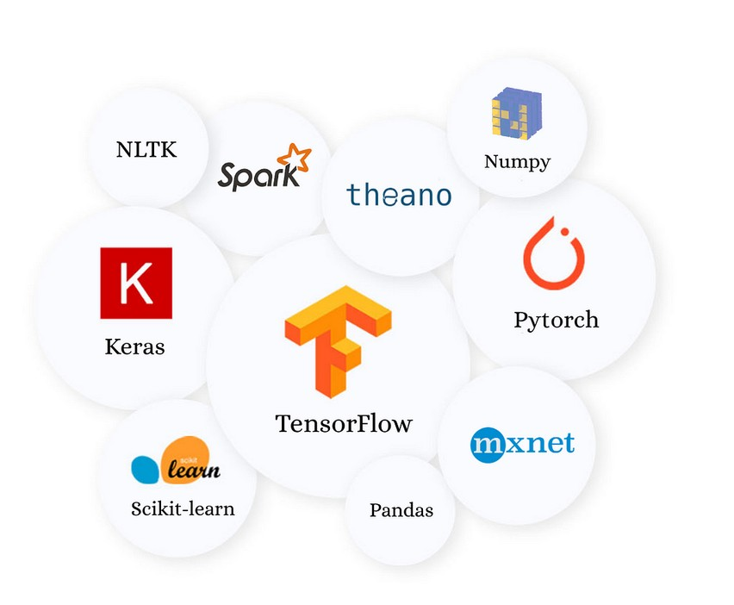
MODULES OF PROJECT:
Numpy Pandas Mataplotlib Scipy
Scikit learn Tensor flow PyTorch Theano

Slide 10
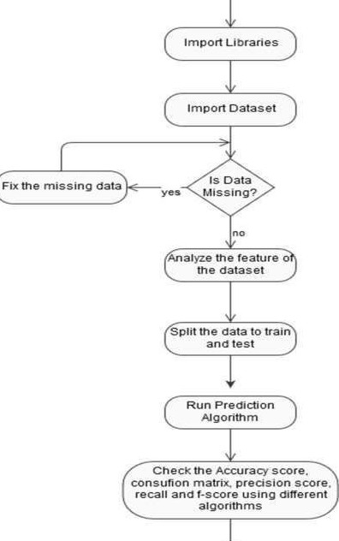
FLOW CHART

Slide 11
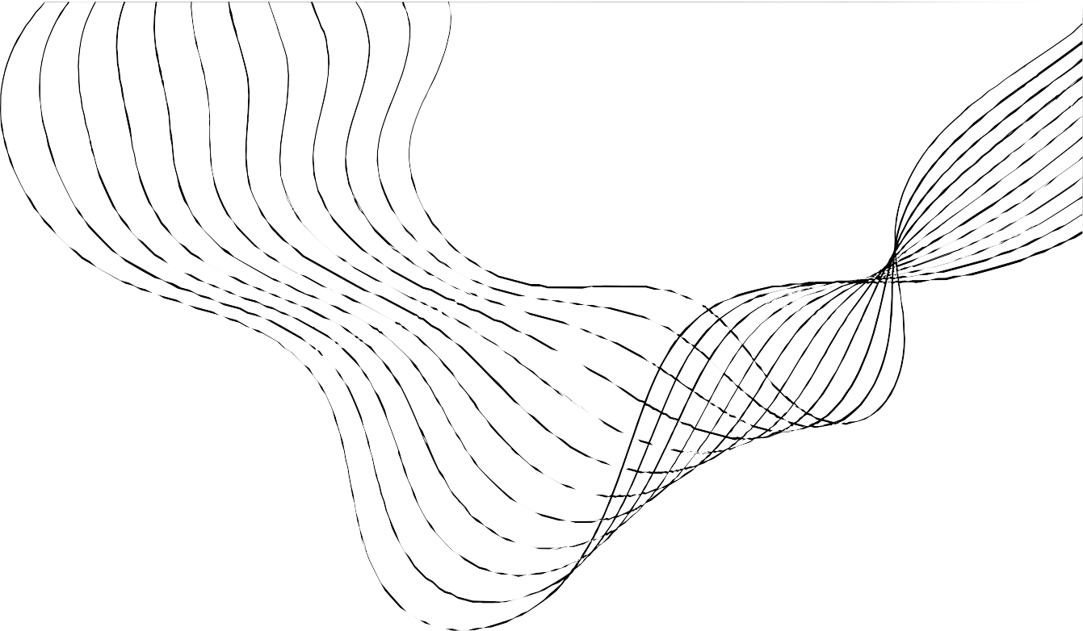
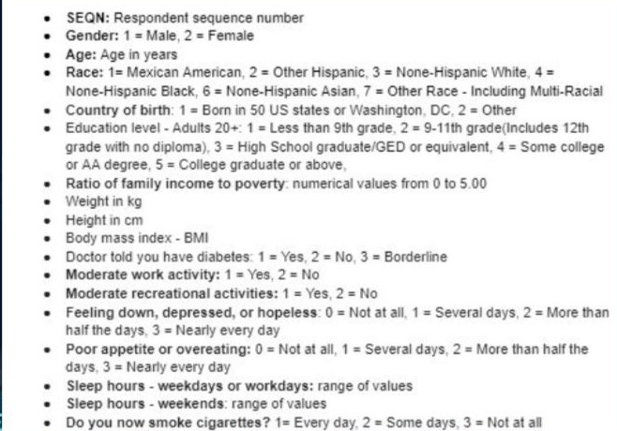
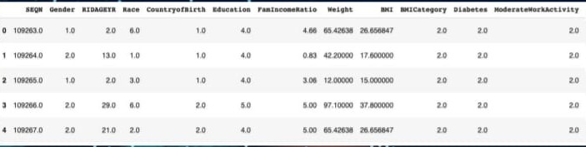
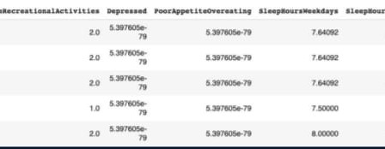
DATASET

Slide 12
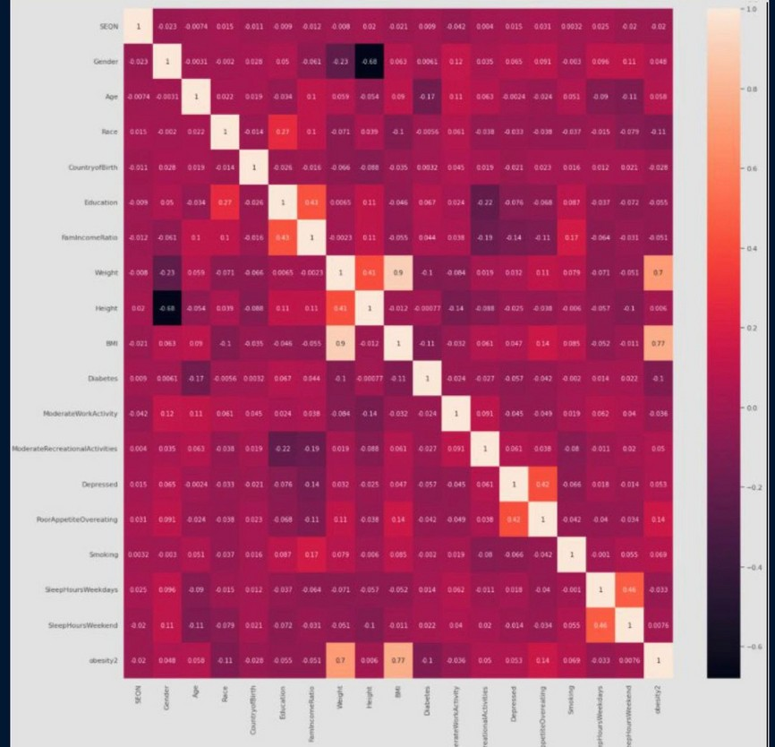

EDA AND VISUALIZATION
EDA & Visualizations
Heatmap shows the correlation between different risk factors.
-
Obesity level is highly correlated with weight and BMI.
After removing BMI and Weight, we can see that obesity level related to Poor appetite/overeating, diabetes, and race.
High correlation: Poor appetite/overeating and Depressed; Education and Family income ratio;
Height and Gender;
STRATEGY N° 1
STRATEGY N° 2 STRATEGY N° 3

Slide 13
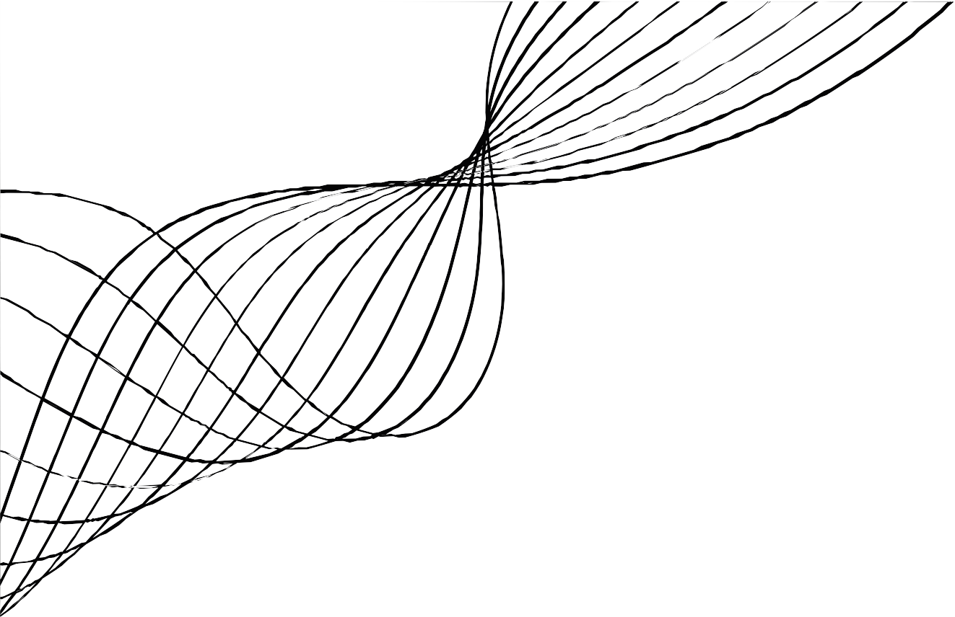
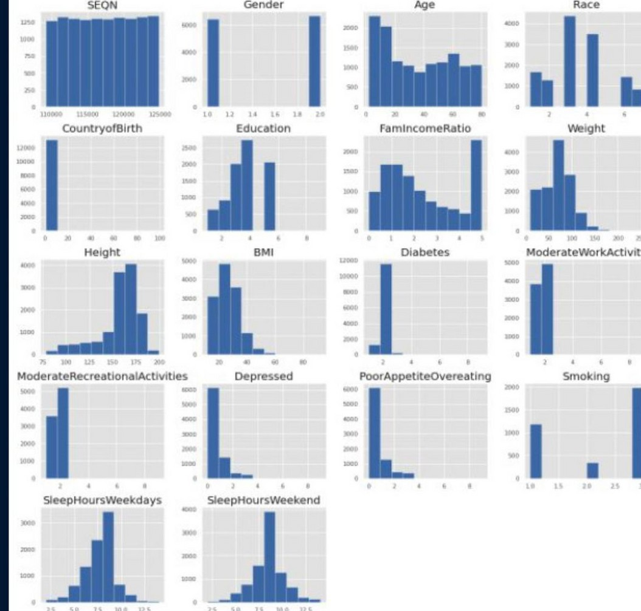
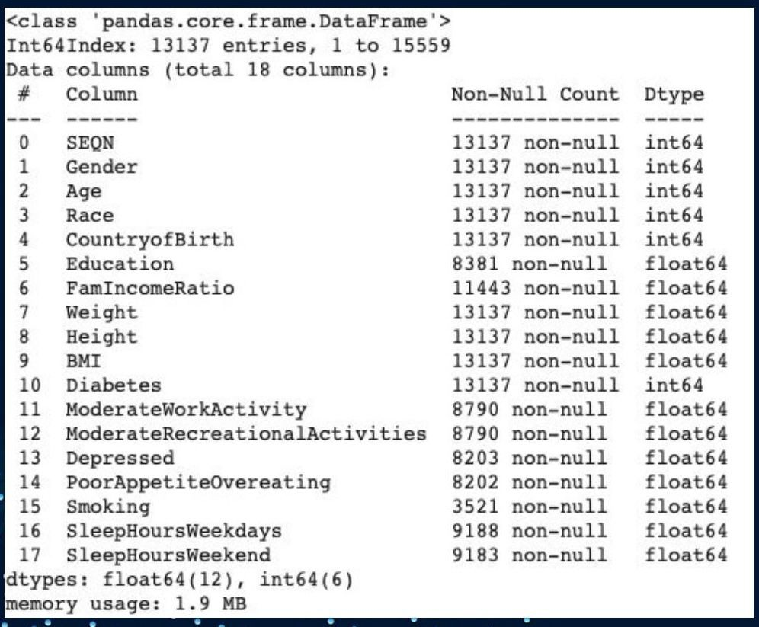

EDA & VISUALIZATION
Everest Cantu
Ceo Of Ingoude Company
Drew
Holloway
Ceo Of Ingoude Company
Remy Marsh
Ceo Of Ingoude Company
Basic histogram shows data distribution and frequency counts.

Slide 14
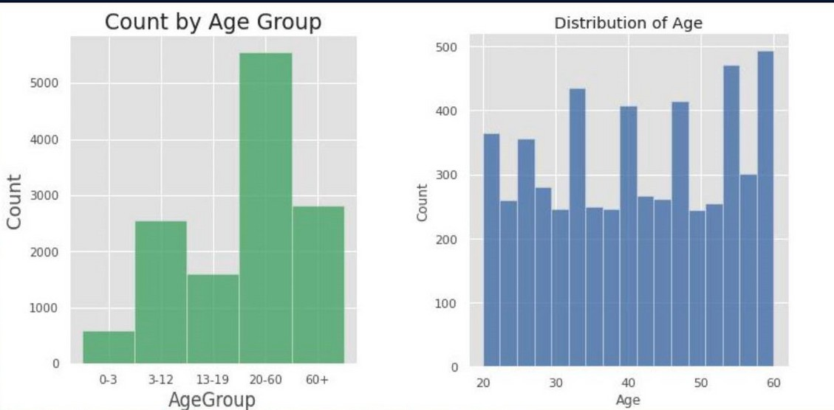
EDA & VISUALIZATION
Dataset contains infants, children, teenagers, adults, and seniors.
- Added a new column and separated respondents to different age groups.
Respondents below 20 or older than 60 years old - Missing information such as education, family income ratio, diabetes, activities, eating disorder status, and smoking habit.
Decided to extract the respondents' data between 20 to 60 years old to a new data frame.

Slide 15
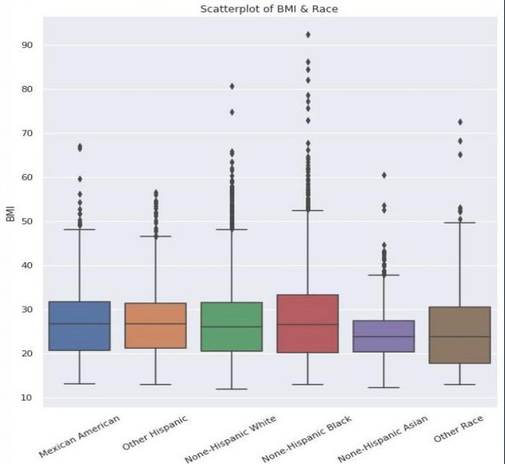
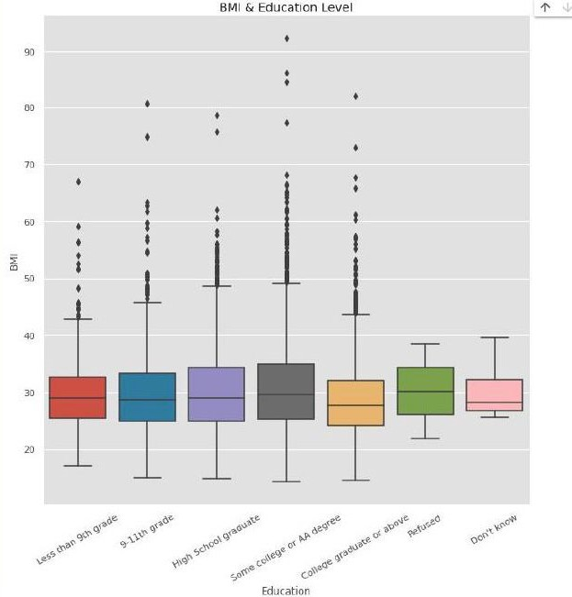
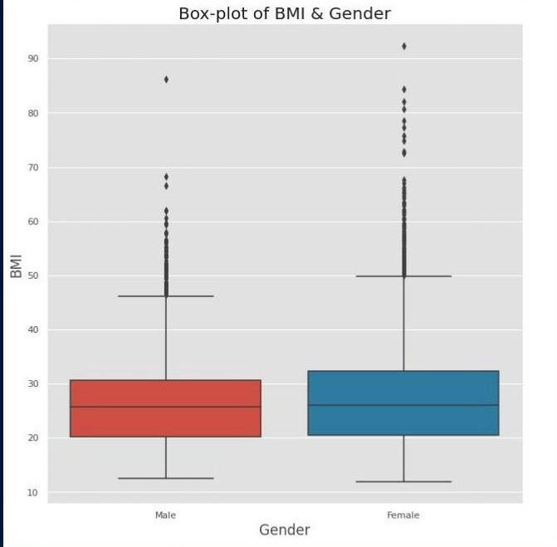
EDA & VISUALIZATION
1-Female respondents have slightly higher BMI than Male respondents.
2-Hispanic Asians have lower BMI compared to other race groups in our dataset.
3-People with college or above education level tend to have lower BMI.

Slide 16
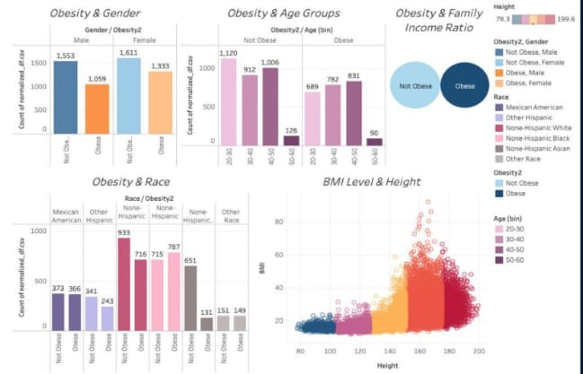
Dashboard:
https://bublic tableau.com/views/Boo k116381205995830/Dashboardi2:lang uage=en US&displav counten&origi nEviz share link

Slide 17
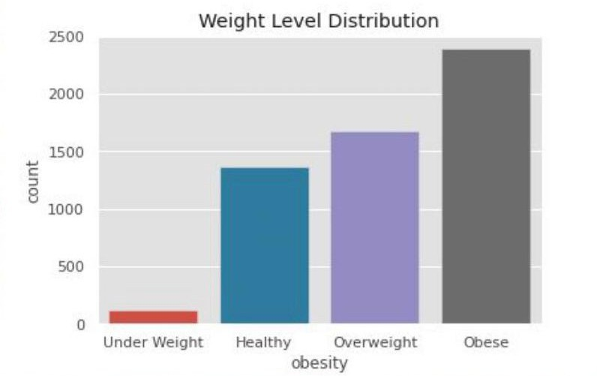
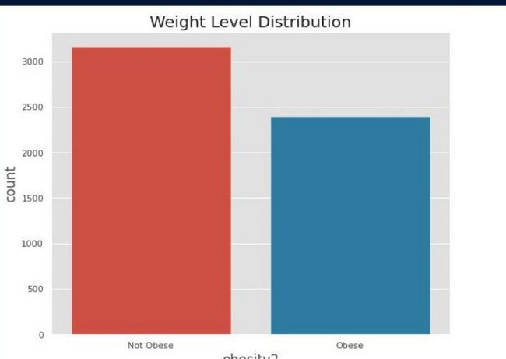
Prepration & Model Construction
After checking weight distributions we discovered that there was a class imbalance thus, we combined the respondents from the underweight, healthy, and overweight groups together and kept the obese group
separate. (1 = Not Obese, 2 = Obese)
Dropped Weight and BMI from the dataset: Weight and BMI are highly correlated with obesityloverweight Normalized the data using mean-max transformation which scaling each variable to the range (0, 1).
We split the data into training and testing sets at a 80% to 20% ratio.
For our modeling section, we used a total of 6 models: Baseline, Random Forest Logistic Regression, SVM, Decision Trees, and XBoost to predict accuracy and feature importance of risk factors

Slide 18
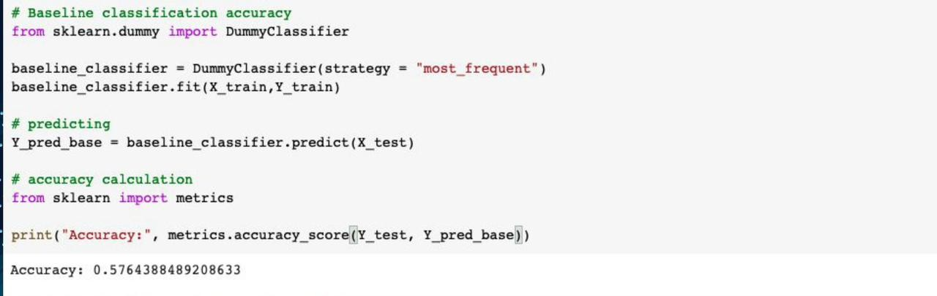
Base Line Model
We decided to create a baseline classification model as a benchmark
A simple model that provides reasonable results on a task or a metric you would hope any model could beat.
DummyClassifier is a classifier that makes predictions using simple rules. We use this to build a baseline model to compare with other models.
The baseline model has a 57.64% accuracy, which indicates the lowest possible prediction we can get. We
expect to get higher accuracy from other models we selected.

Slide 19
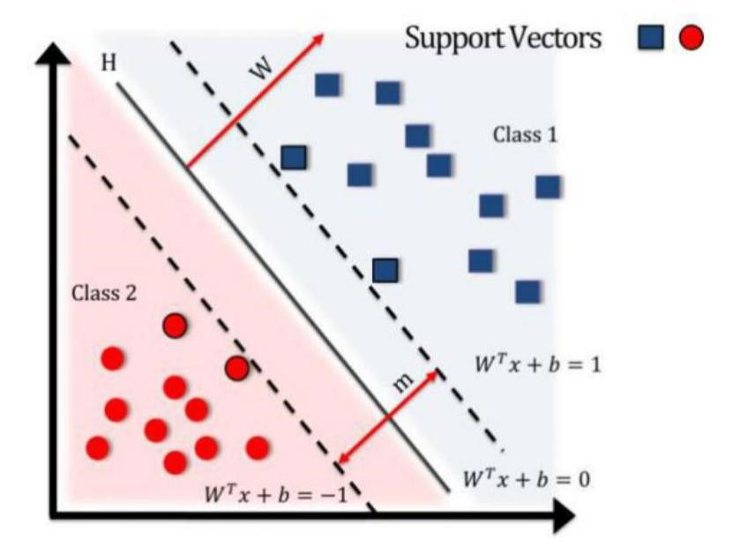
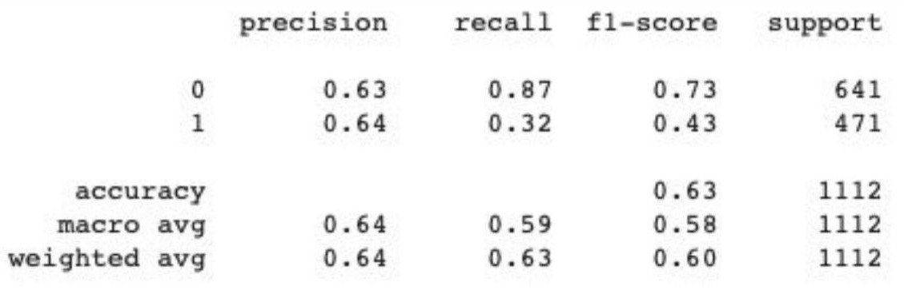
SVM MODEL
Support vector machines (SMs) are a set of supervised learning methods used for classification, regression, and outliers detection.
Given labeled training data (supervised learning), the algorithm outputs an optimal hyperplane which categorizes new examples.
The accuracy rate of the SVM model is 63.49%, the cross validation score is 60.91%.
The precision rate of the SVM model is 64%, the false-positive rate is 87% which indicates is not good fit.

Slide 20
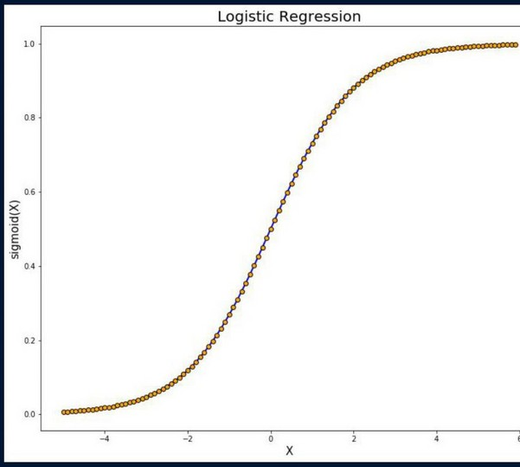
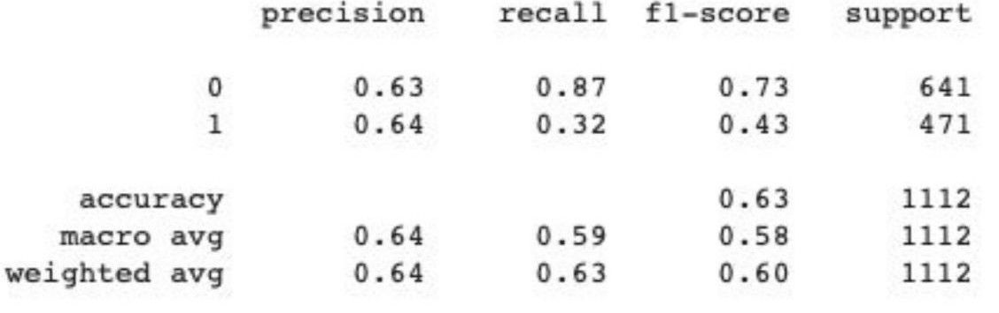
Logical Regression
Logistic regression is a supervised learning classification algorithm used to predict the probability of a target variable. It is mainly used when the target variable is categorical.
The accuracy is 61.33%, cross-validation is 60.62%, the accuracy and cross- validation score are not high, but they are close to each other.
The precision rate is 57%, and the false positive rate is 81% which shows this is not a good model for our dataset.

Slide 21
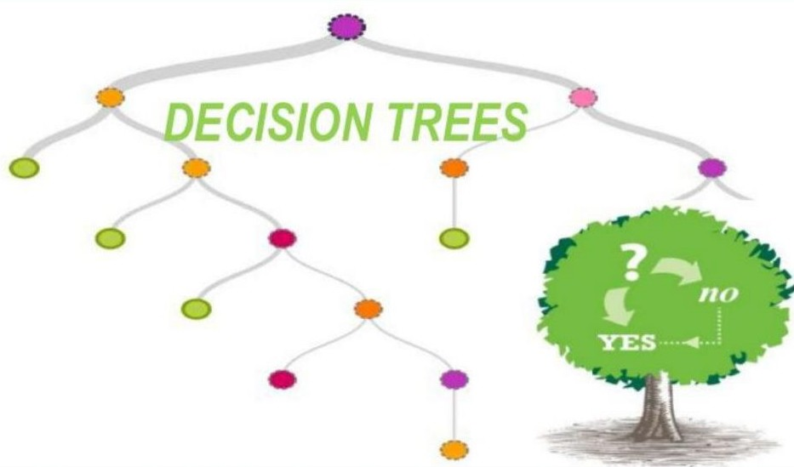
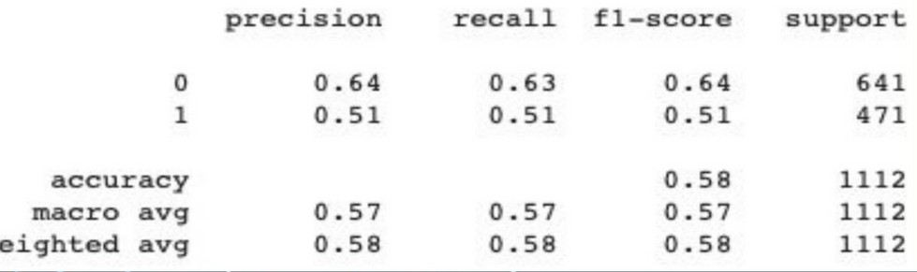

Decision Tree Model
The goal of using a Decision Tree model is to create a training model that can be used to predict/classify the value of the target variable by learning simple decision rules inferred from training data.
Decision Tree Model result shows the accuracy as 58.13% and cross validation score as 57.05% for our dataset.

Slide 22
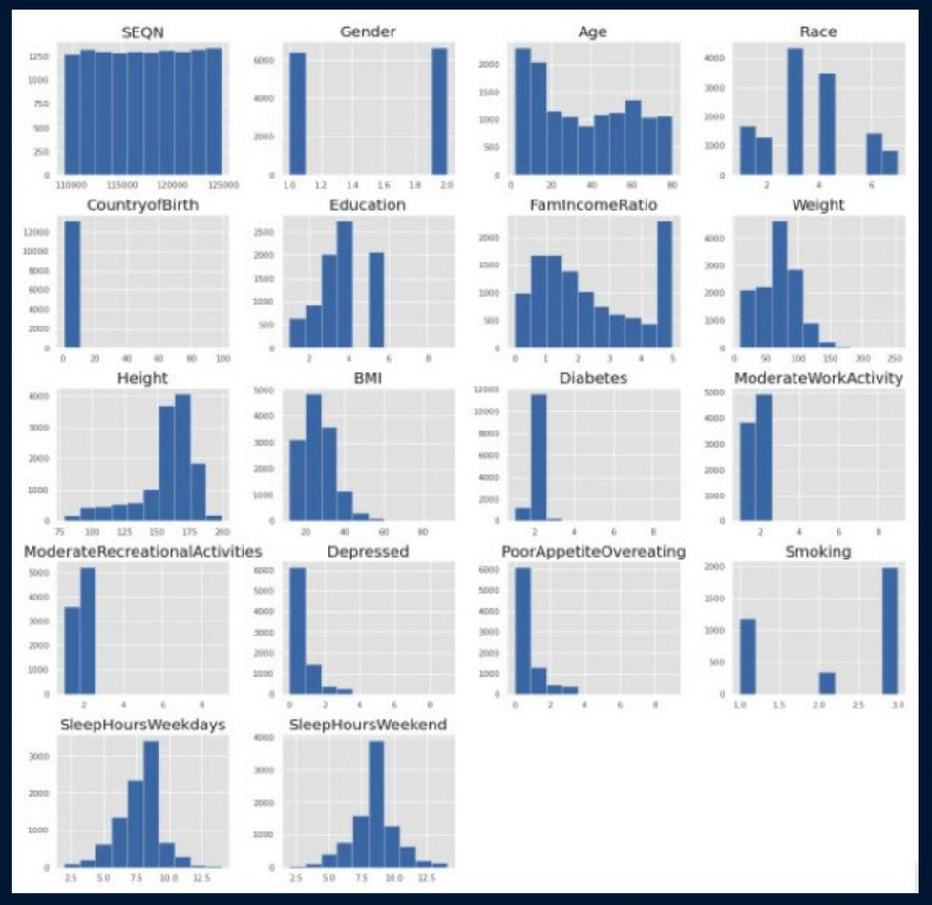
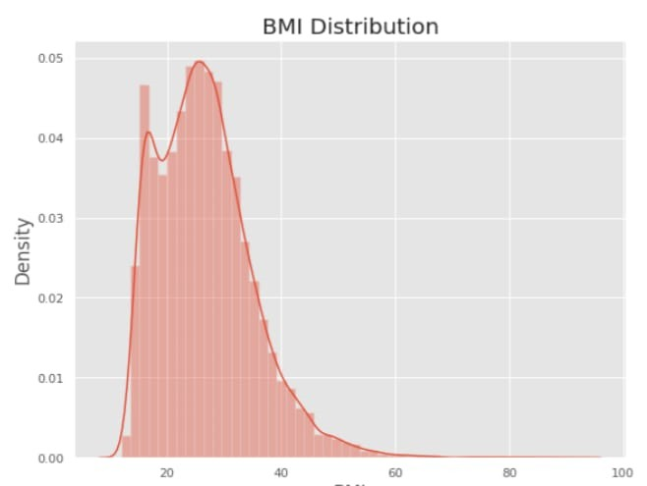
Screen Shots
Histogram
BMI Distribution

Slide 23
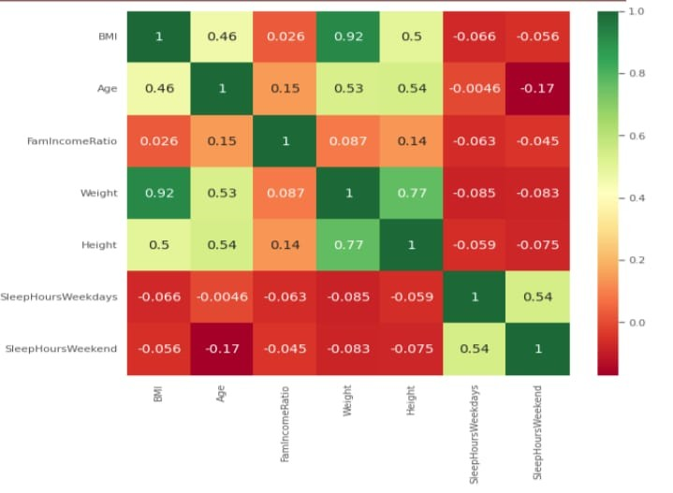
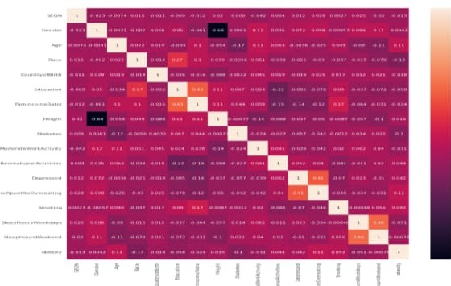
Snap Shots
HeatMap
Download

Slide 24
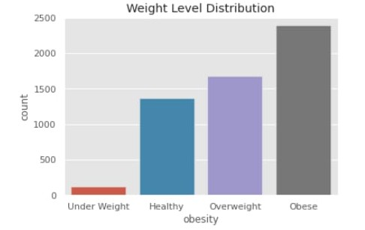
Weight Level Distrubition

Slide 25
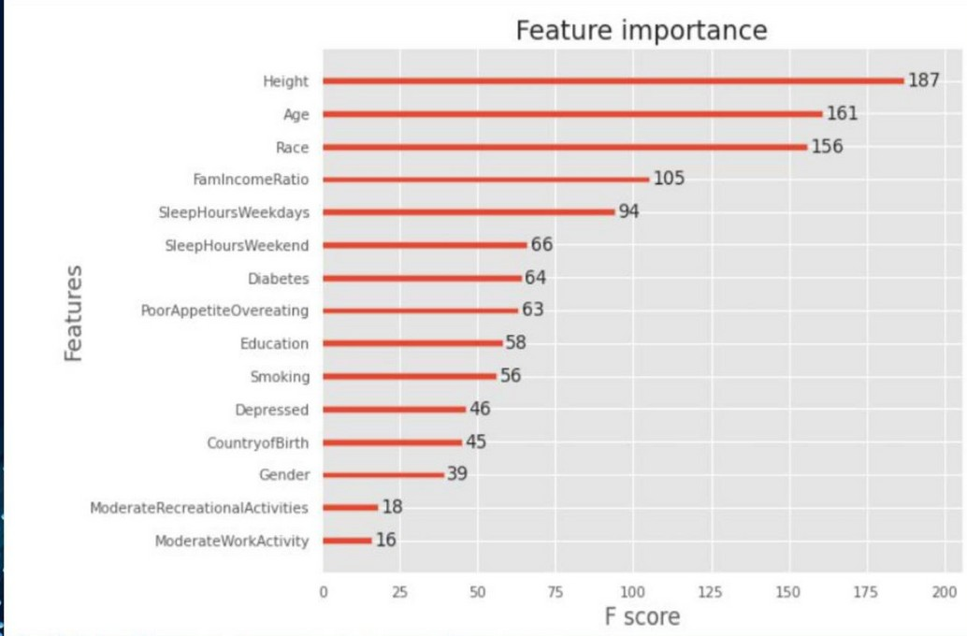
CONCLUSION
Although the accuracy levels from our models were considerably low, we do have a significant improvement compared to the baseline model. The XGBoost Model provided the best accuracy score compared to the other models so we decided to check the feature importance
The top 6 risk factors are Height, Age, Race, Family income ratio, Sleep hours on weekdays, and Sleep hours on weekends.
In our literature review, we learned that depression can affect obesity levels.
However, based on our analysis we can not say that mental health is highly
affecting obesity level.

Slide 26

REFERENCES
https://blog.cmu.edu/2020/08/31/3-baslines/ https://blog.insightdatascience.com/always- start-with-a-stupid-model-no-exceptions- 3a22314b9aaa https://xgboost.readthedocs.io/en/latest/pyth on/python_api.html https://www.datacamp.com/community/tutori als/random-forests-classifier-python

Slide 27

yo

